Slide 1
Adventure Works
Database Modelling and Visualization
Akshay Agrawal

Slide 2
Q-1
Entity Relationship Diagram

Slide 3
Conditional Assumptions
Experience: # of Days/Years(Modified Date, Hiring Date)
Contacts Tbl includes all entities (Consumer, Employees, etc)
Every Entity can have exactly one contact (Latest)
a) One Address can have multiple customers
b) One Customer can have multiple addresses
5. a) A sales territory belongs to just one country
b) A country can have multiple Sales Territory
6. a) Customers have multiple credit cards
b) Credit Cards have exactly one owner

Slide 4
Continued...
7. a) A Country can have multiple currencies
b) One currency can belong to multiple countries.
8. An order has exactly one mode of shipping.
9. One Employee belongs to exactly one department.
From ERD Notations, Similar conditions can be inferred.

Slide 5
Missing Data Assumptions
These new tables’ schemas created for completeness and connectivity.
Shipping Methods
Credit Cards
Currency Exchange
Customers
Country
Shift
Department
Address Type
State Province

Slide 6
ERD (Crow’s Feet Notation) & Terminology
PK Primary Key
FK Foreign Key
UK Unique Key
CUK Composite Unique Key
CPK Composite Primary Key
User Defined Data Types
money decimal(19,2)
smallmoney decimal(5,2)
flag bit

Slide 7
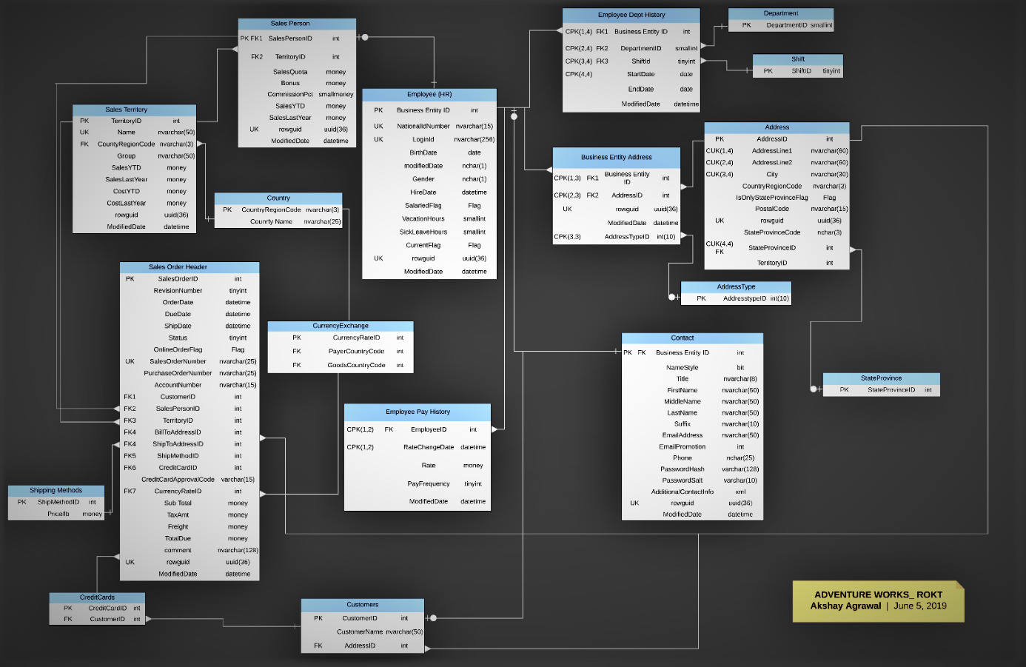
Link to High Definition ERD

Slide 8
Q-2
Connecting Data...

Slide 9
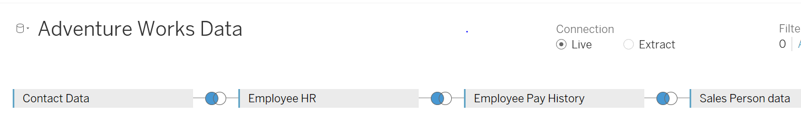
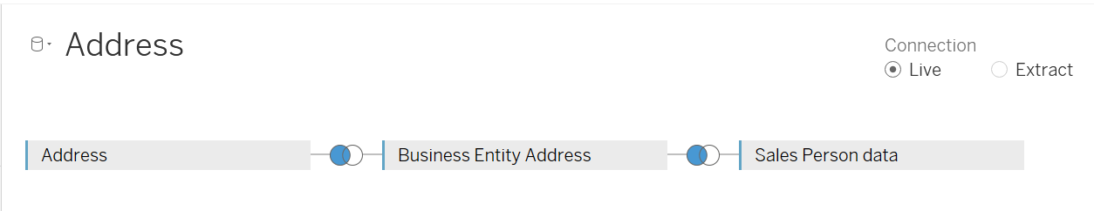
Joins

Slide 10
Calculated Terms
Quota-Sales-Flag Meet(sales > quota) ,Not meet (otherwise)
NewQuotaFlag Meet( sales > new quota), Not meet (otherwise)
No Value Hours Sick Leave + Vacation Leave
FMRatio (# Female / # Males)* 100
Days of Work # of days from hiring till modified date
RateByExperience Rate/Years of Work

Slide 11
Calculated Parameters
Abbreviations
New Sales Quota Controller for Setting New Sales Quota
HeadRecords/(Field :Index) Retrieving N sorted/top records.
NVAH: Non Value Added Hours Sick Leave + Vacation Leave
Name First Name + Last Name
Org Organization

Slide 12
Q-3
DATA TABLES
WITH
IMPROVED READABILITY

Slide 13
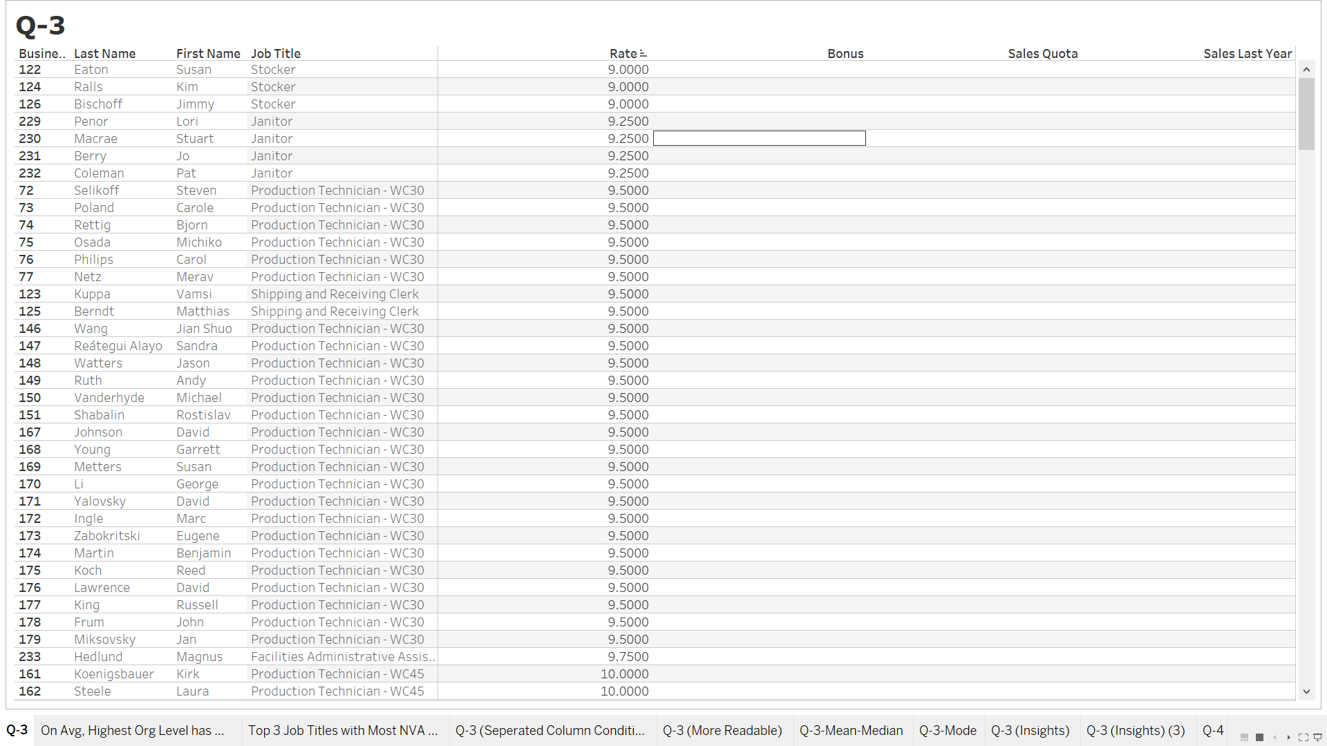

Slide 14
IMPLEMENTATION 1 (FOR READABILITY)
Conditionally Formatted Rows based on Quota Flag
Red Row band shows Old Sales Quota not fulfilled.
Big Numbers to Thousands (#K) format
Use of Highlighters and Shading
Merged Last Name and First Name as “Name”
Applying Drop Down Filters For Job Title, Quota Flags
Better Font Formattings and visibility.
Group First By Job Title

Slide 15
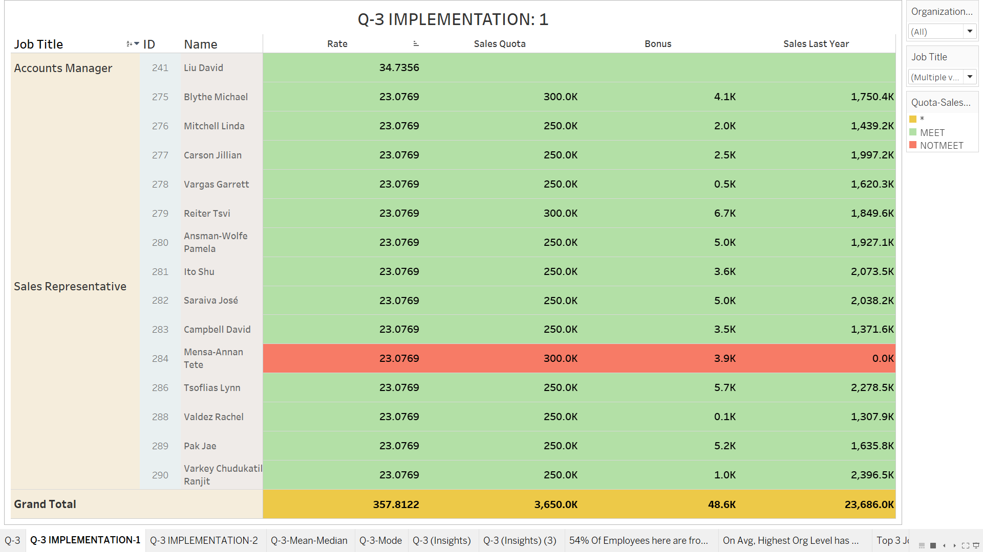

Slide 16
IMPLEMENTATION 2 (FOR READABILITY)
Conditionally Formatted Column Wise
Colored Each Field Separately
Numbers Sized and colored based on their values
Use of Highlighters and Shading
Merged Last Name and First Name as “Name”
Applying multiple Filters For Job Title, New Quota Flags
Group First By Job Title

Slide 17
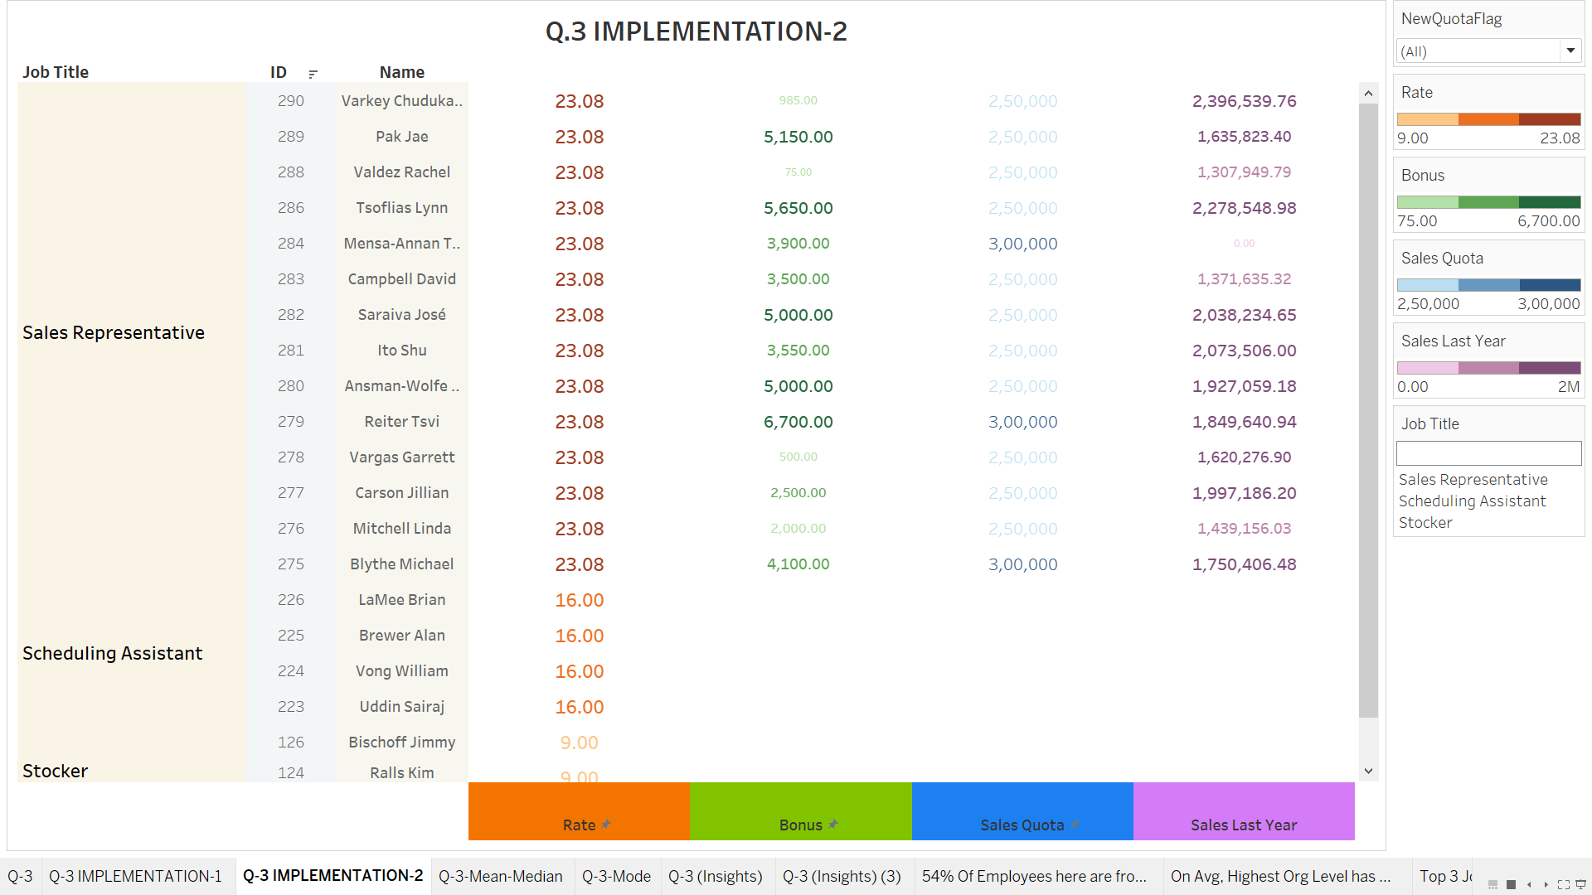

Slide 18

Q(3) (1)
Who has the paid the highest salary rate in the firm?
B. What is their job title?

Slide 19
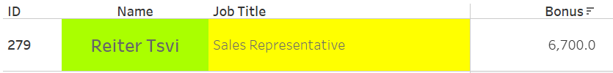
Q(3) (2)
Who got the highest Bonus last year?
B. How much?

Slide 20

Q(3) (3)
Which salesperson had the highest sales last year?
B. How much?

Slide 21
Q(3) (4)
Did any of our salespeople not meet their quota?
B. If so, who was it?

Slide 22
Q(3) (5)
What is the mean rate of pay? : 18.188
B. Median? : 14.000
C. Mode? : 9.5

Slide 23
Q(3) (6)
Interesting Insights
Assumption : Drawing insights only from the prepared table.
For generalizations
we should use Inferential stats
Statements are just based on the data

Slide 24
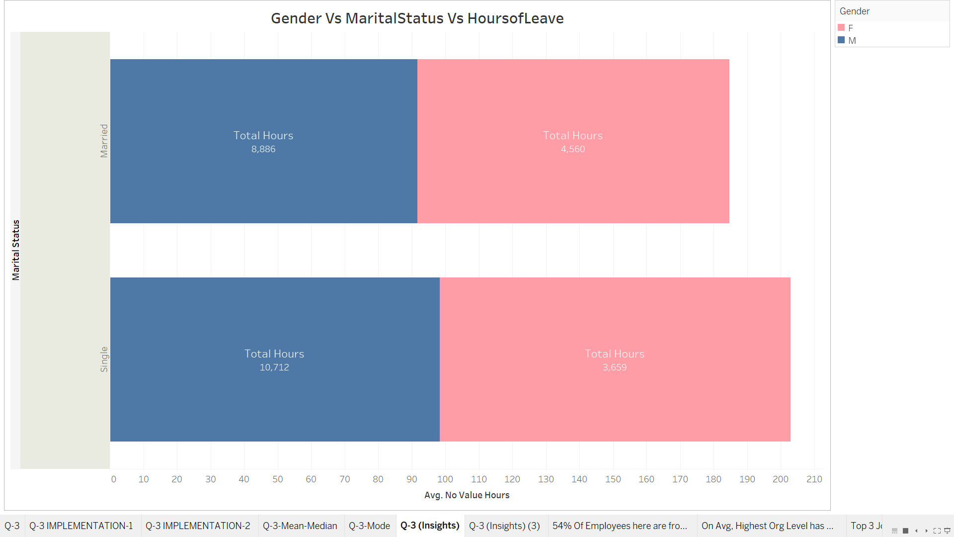
Visualization 1

Slide 25
Inferences (Visualization 1)
On Average:
Females took more NVA Hours than Males (2.84%)
Singles took more NVA hours than married ones by ~9%
Single Females took more NVA hours than married Ones by 12.33%
4. Single males took more NVA hours than married ones by 7.28%

Slide 26
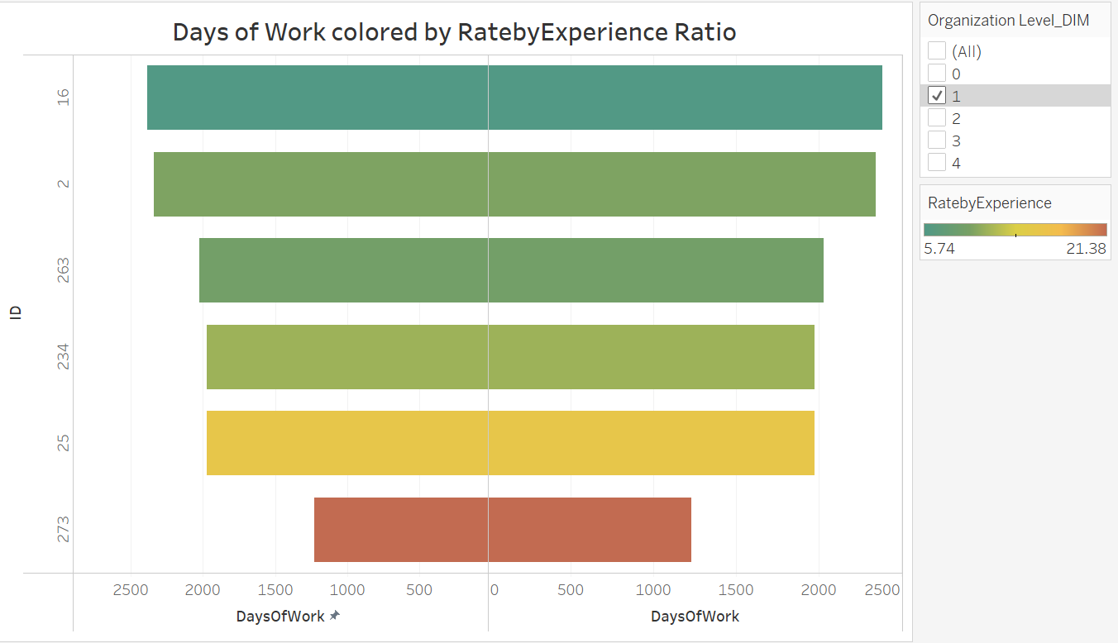
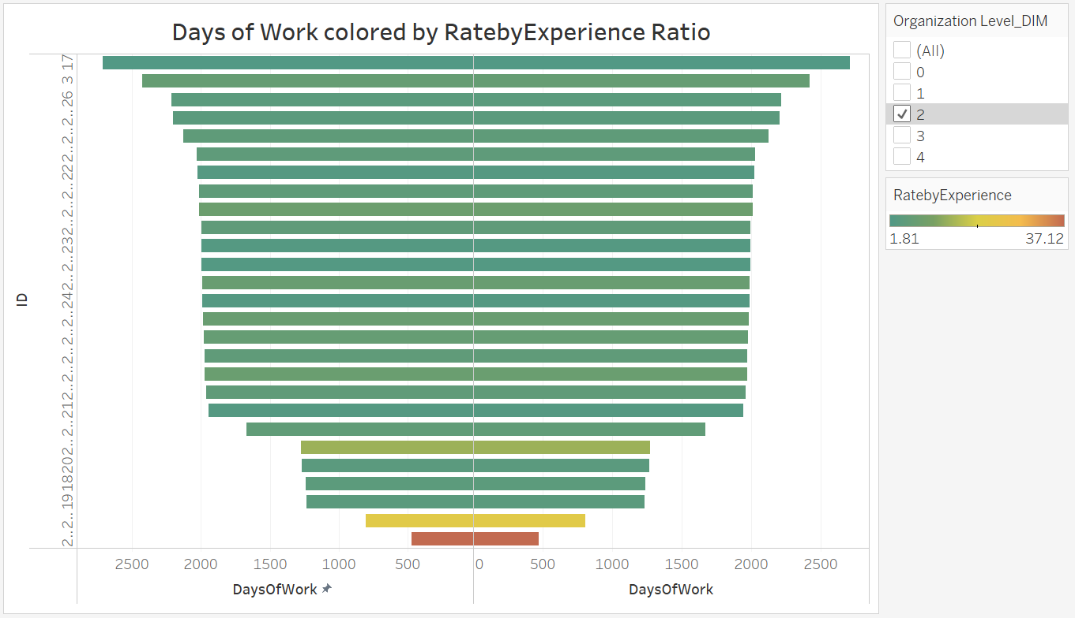
Visualization 2

Slide 27
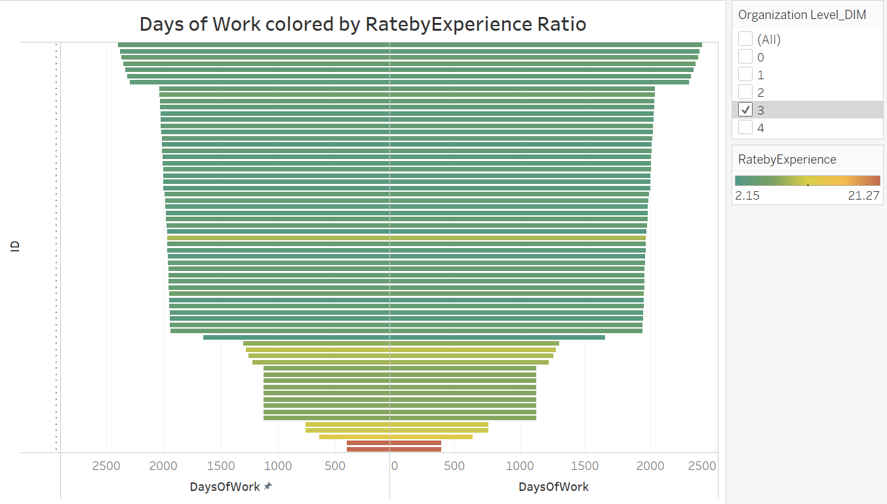
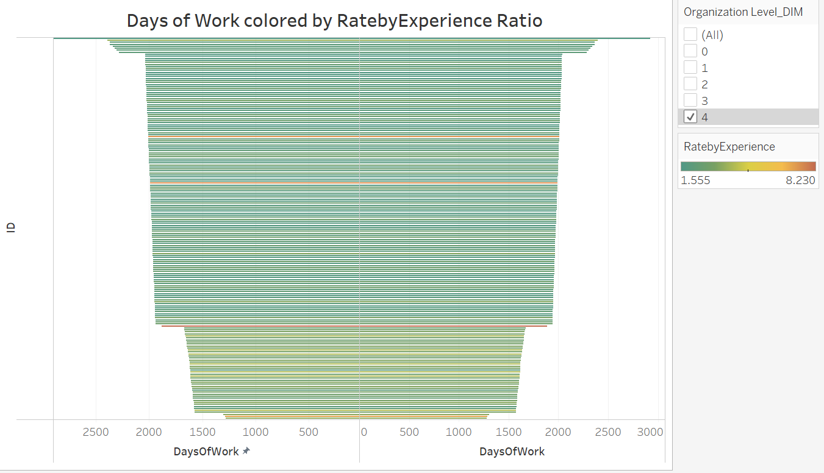
Visualization 2 (contd.)

Slide 28
Inferences (Visualization 2)
Slow Increments in rate with experience.
2. For every org level but 4, The employee with min experience is overpaid
3. Similar rates over experience in every org level
4. With experience, more rate changes in every level except 4

Slide 29
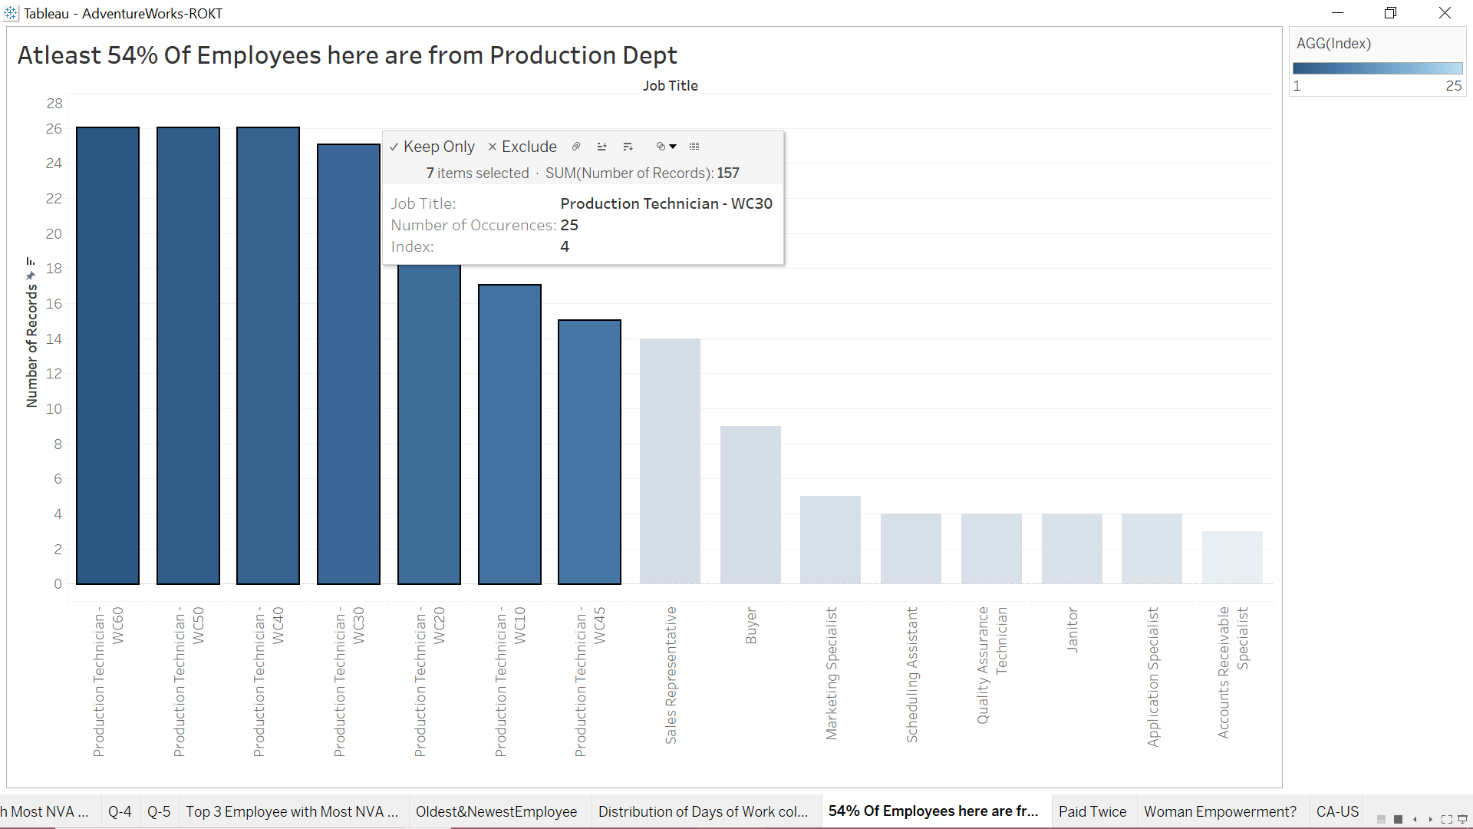
Visualization 3

Slide 30
Q-4
NEW SALES QUOTA

Slide 31
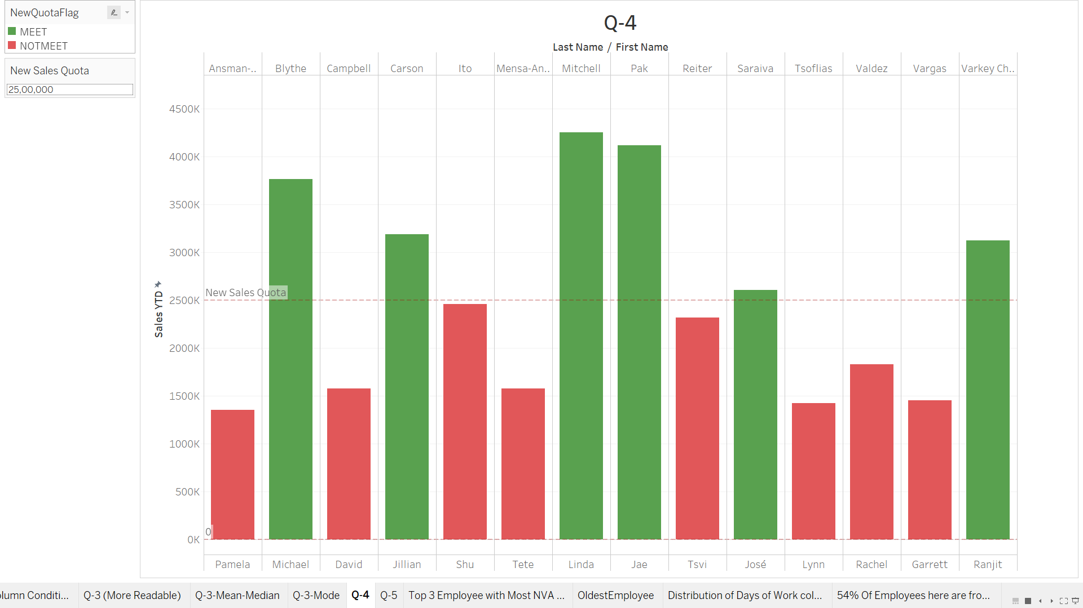
New Sales Quota fulfillment by Sales Employees

Slide 32
Q-5
Salary Rate over time (Day) based on Hire Date
Assumption
We are trying to understand effect of experience on Salary Rate.

Slide 33
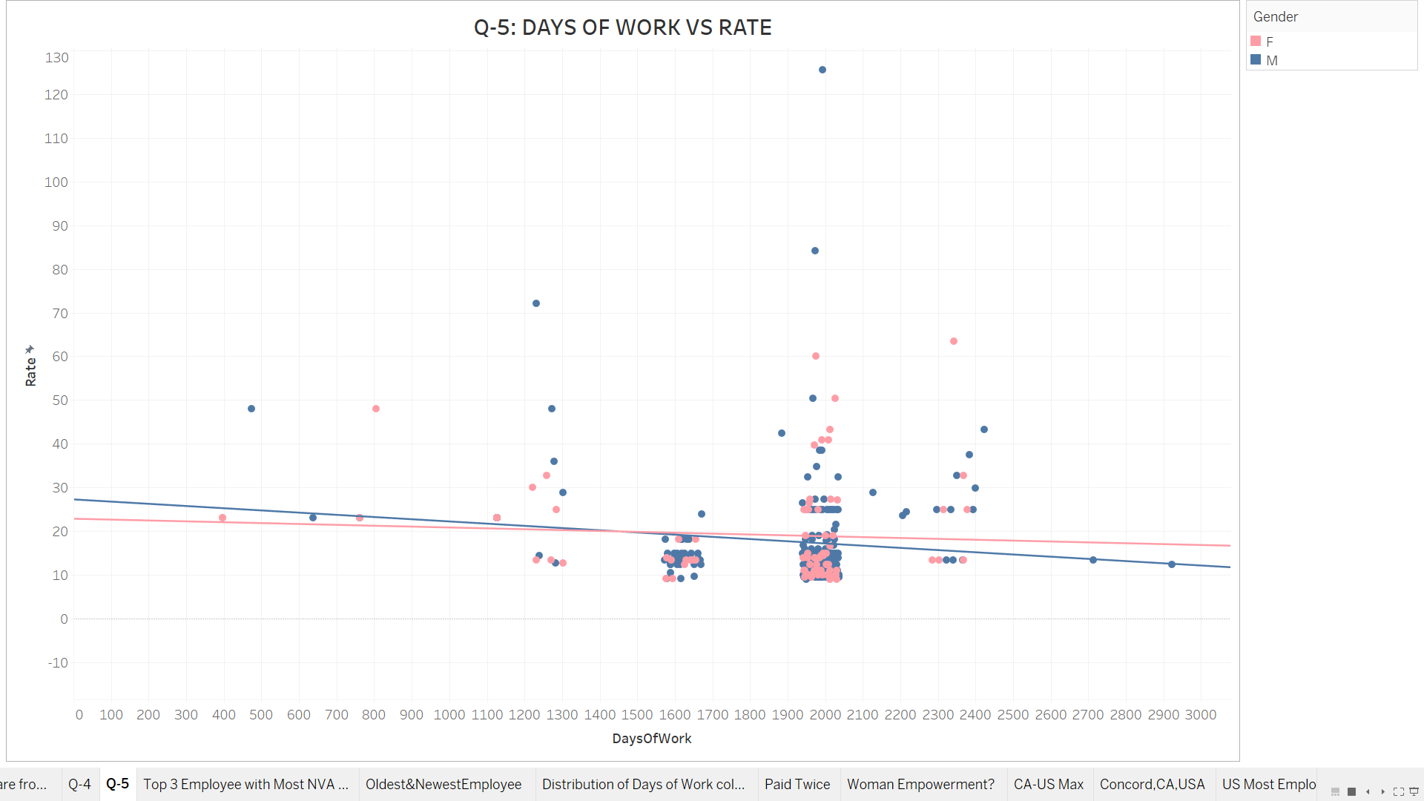

Slide 34
Q-6
Other Insights

Slide 35
Insights Overview
CEO takes maximum NVA Hours. On Avg, Level 1 employees take minimum NVA Hours
Findings:
Job Titles with Most NVA hours
Department wise, Employees with max NVA Hours
Most Experienced and Least Experienced Employee
3. Gender / Marital Status (Taken Separately) does not affect Sales or Rates or NVA Hours (with 95% Confidence)
4. A. Level 4 Employees can be paid once or twice, while other level employees are always paid twice.
B. Are these once paid employees temporary? We can hypothesize this.
C. Female-Male Ratio subsides from top to bottom organization levels.
D. Higher probability of finding a level 4 employee to be a male.
5 . A. Across globe,Majority of our employees are from US.
B. In USA, Majority of our employees are from California.
C. In California, Majority of employees are from Concord
6. Out of 16 Sales Employee, 10 are from USA, while 3 (max) out of them reside in Washington.
7. We only have pay history of US Employees.

Slide 36
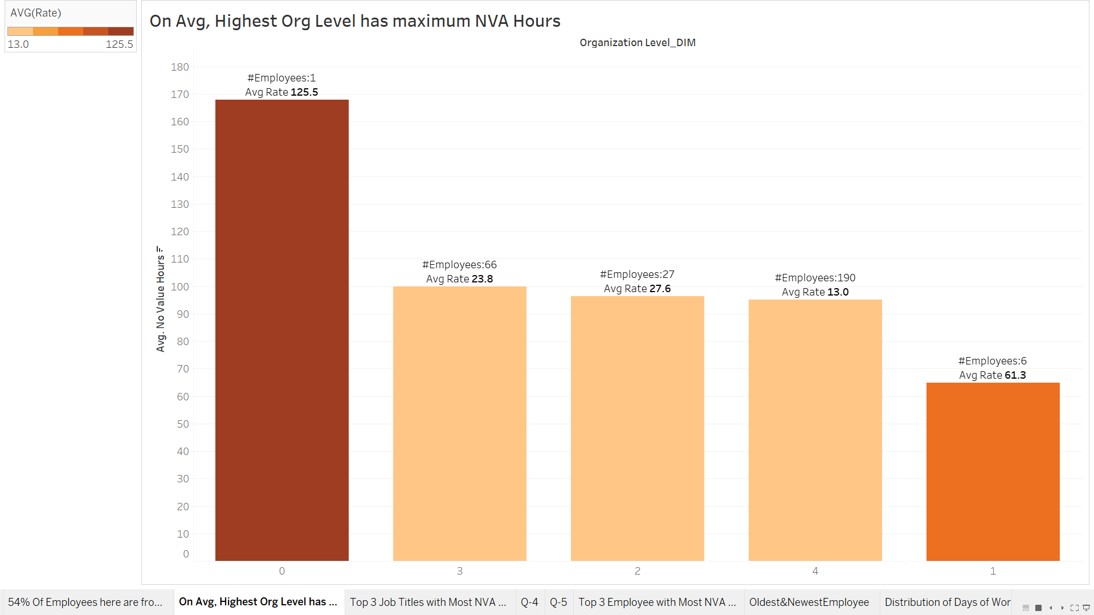
1. NVA Hours

Slide 37
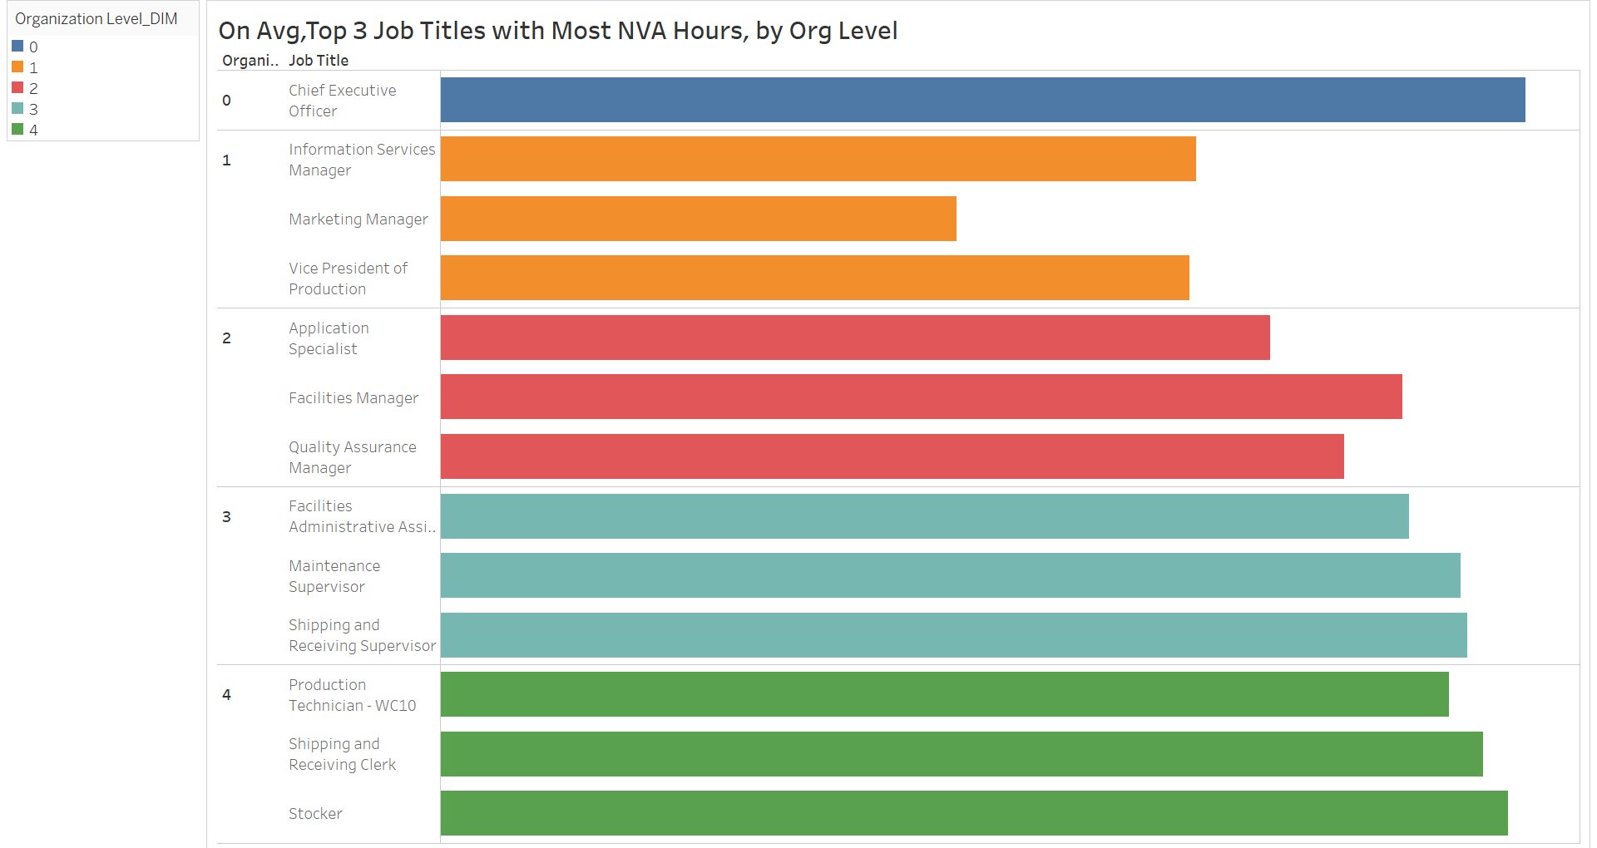
2. A

Slide 38
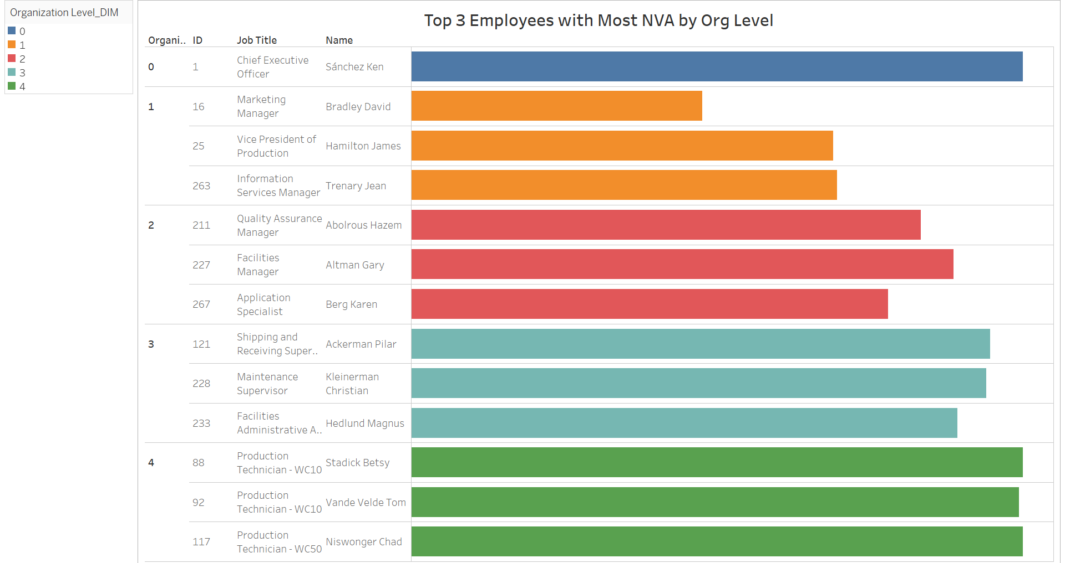
2. B

Slide 39
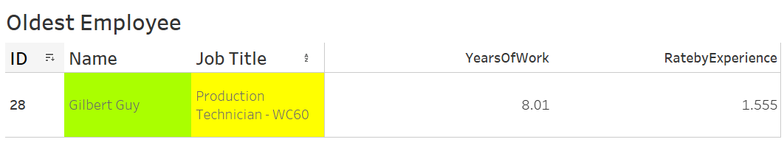
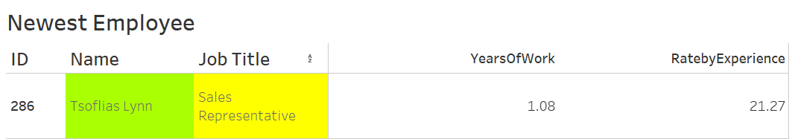
2. C

Slide 40
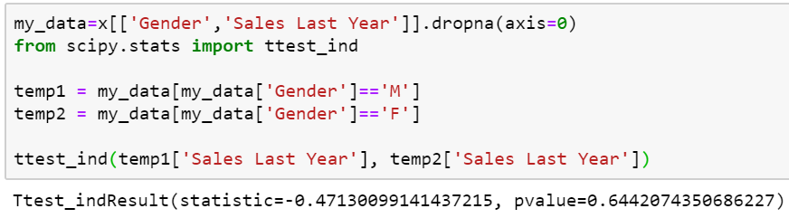
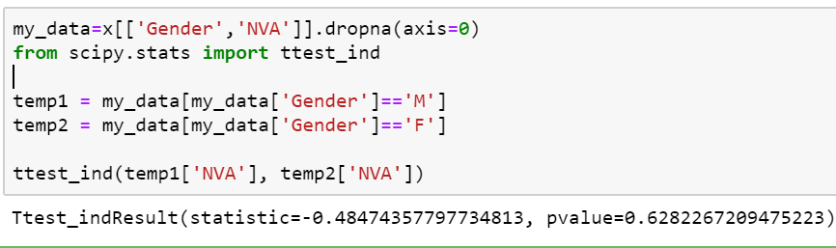
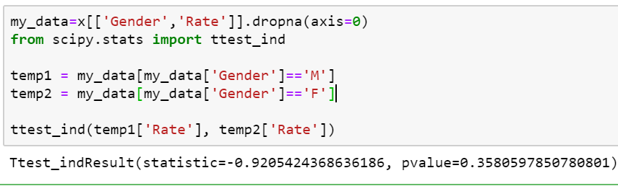
3. Gender does not affect Rate or Sales Last Year or NVA statistically (p>0.05)

Slide 41
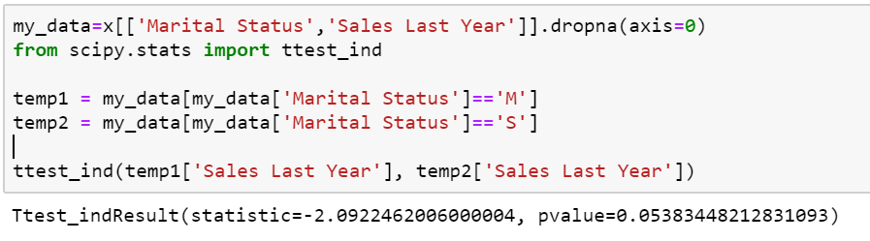
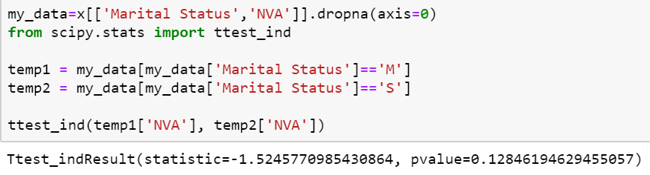
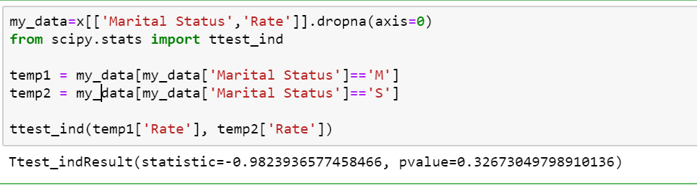
3. Marital Status does not affect Sales Last Year or Rate or NVA statistically

Slide 42
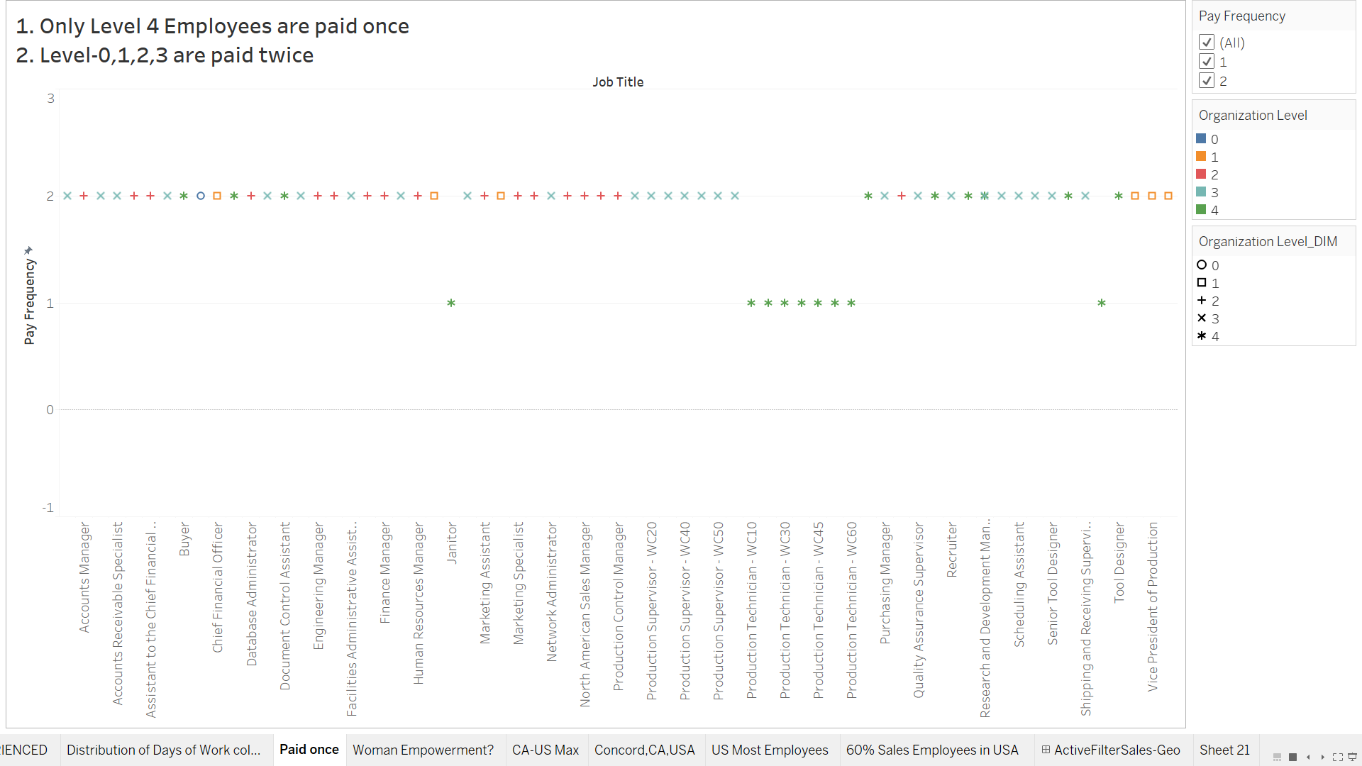
4.A Frequency of Pay per unit by Org level

Slide 43
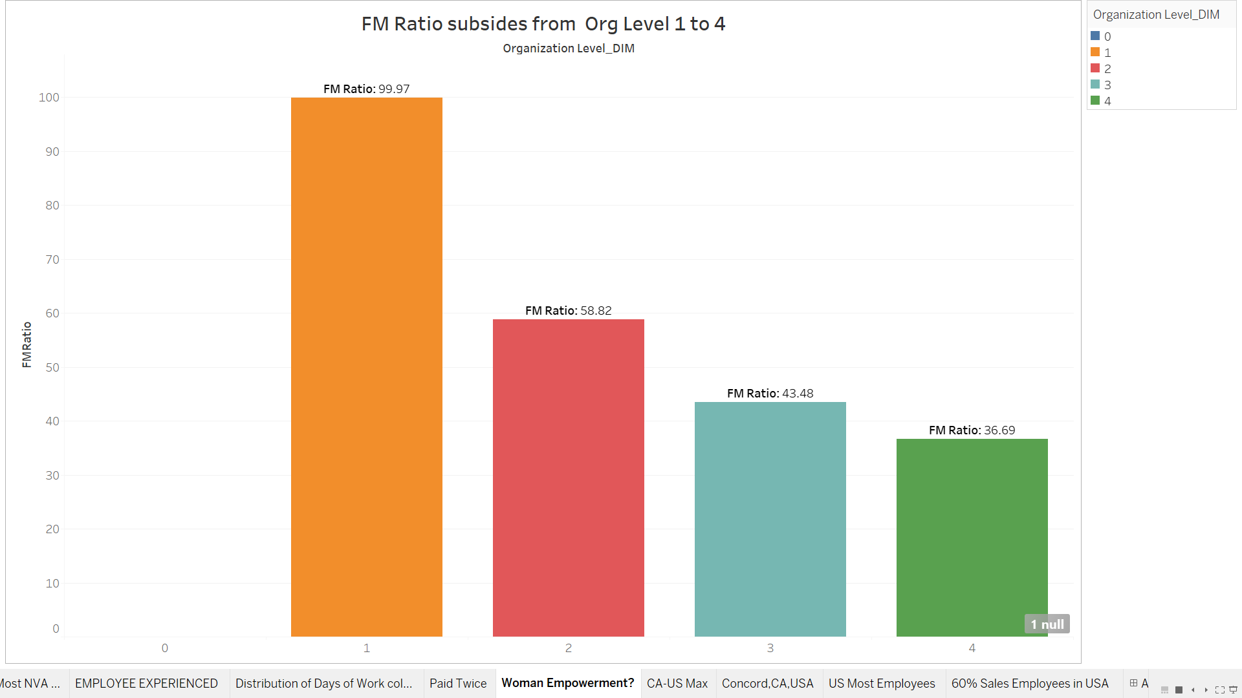
4. Org Level Wise Female-Male Ratio ( 1 Null - Only CEO)

Slide 44
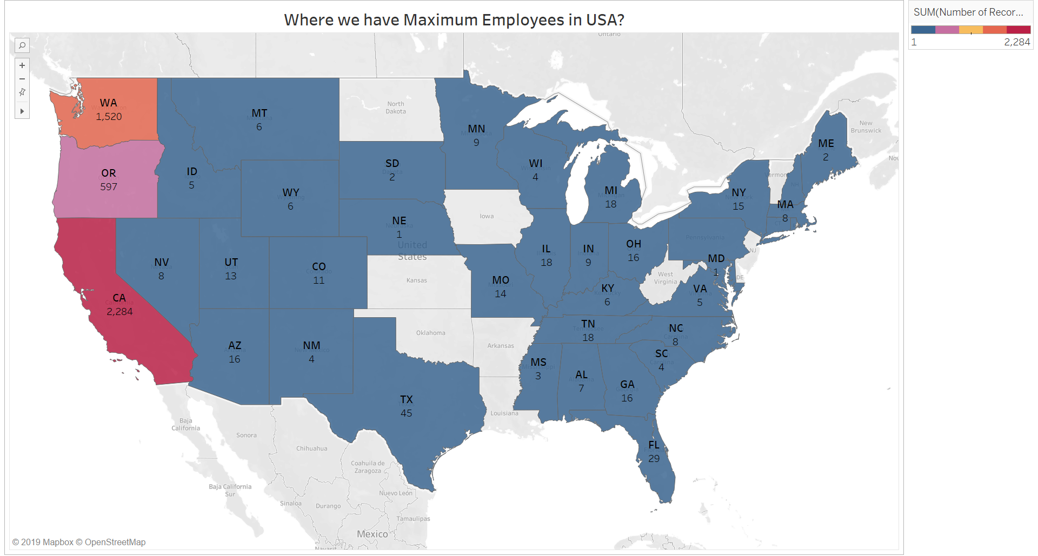
5.B Employee Locations across US

Slide 45
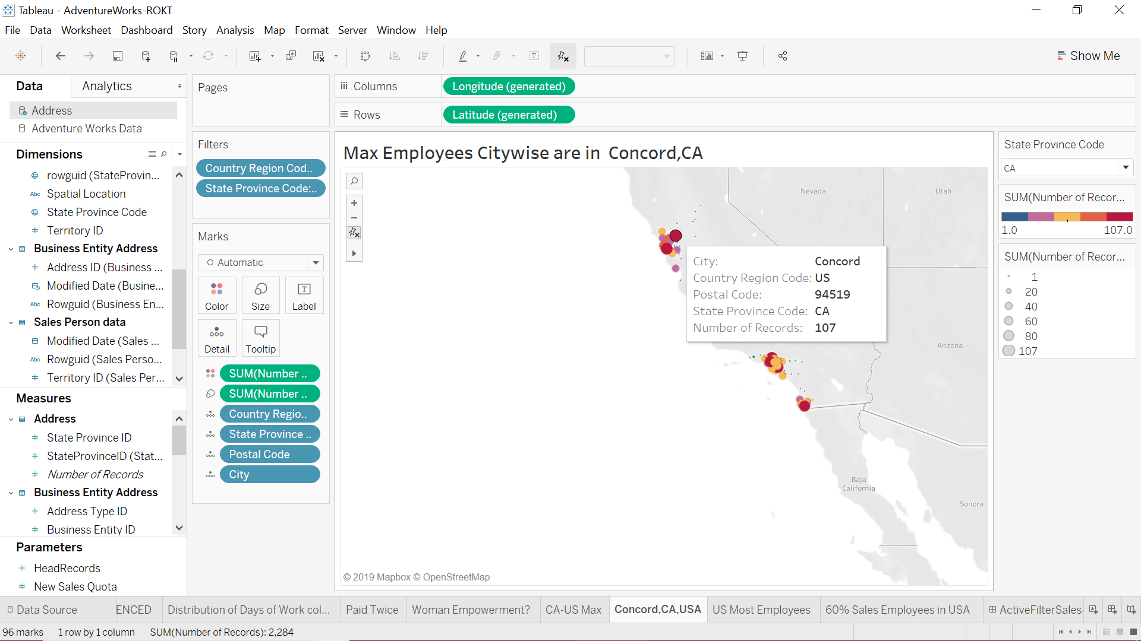
5.C Employee Locations across California

Slide 46
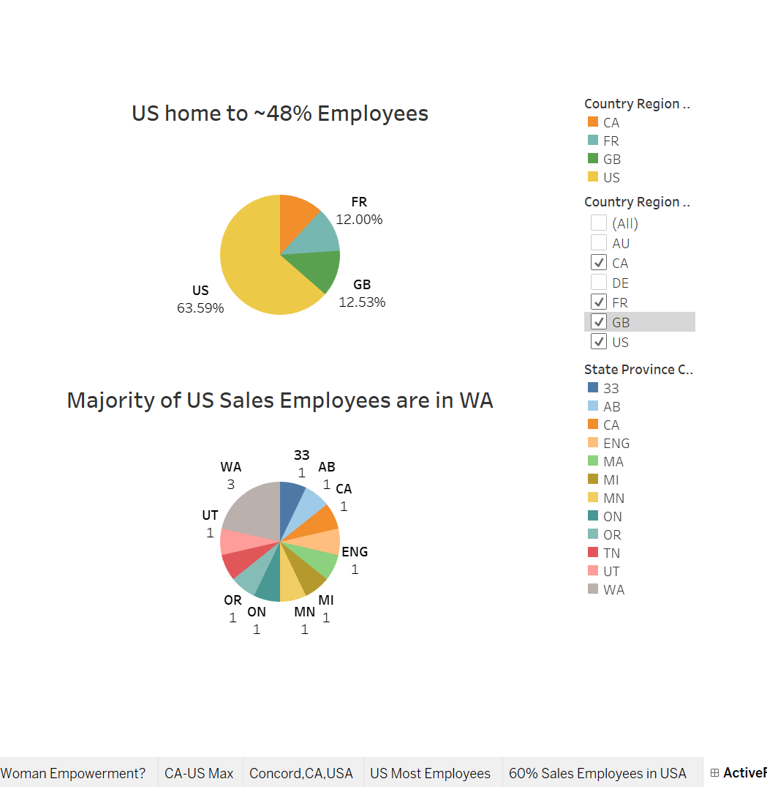
Dashboard & Filter: Dual Pie Charts for In-depth Analysis

